Slide 1


Digital Logic Design project Remote PowerPoint Controller
Made by ; AHAD AZIZ K213241 MUHAMMAD USMAN K214921

Slide 2

Introduction: .
To create a simple and inexpensive PowerPoint presentation remote controller

Slide 3
Functionality and Features:
The IR receiver will receive the signal from IR remote and forward it to the Arduino connected to the computer. The Arduino will then compare the signal with a list of commands and their IR signals through the program installed in it and determine which command to follow and the computer will execute the command.
User can start, play, pause and end the PowerPoint presentation when the device is connected to a computer or laptop, with access of the remote control.

Slide 4
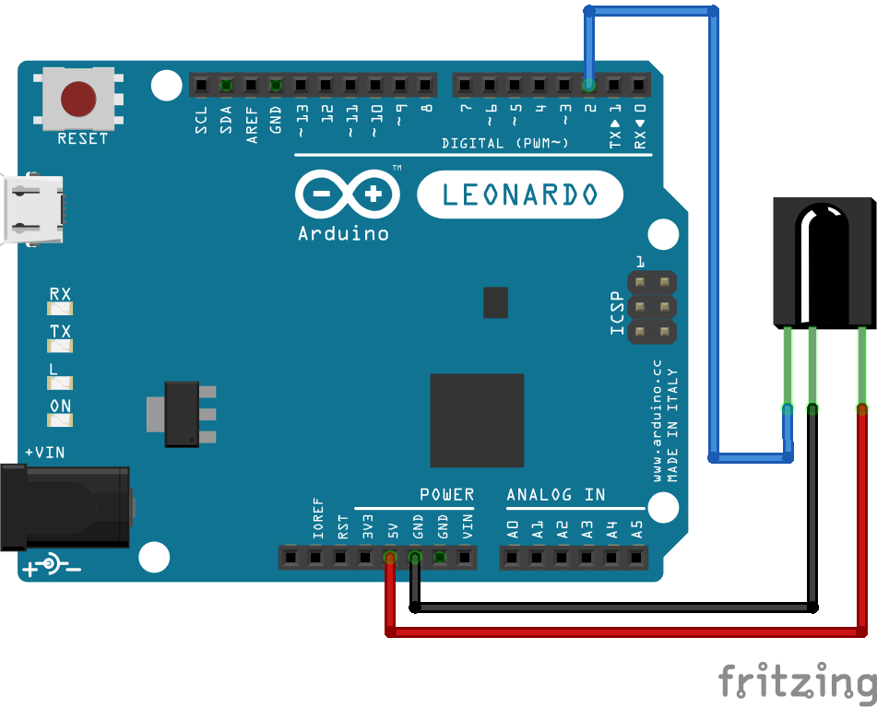
Circuit Diagram

Slide 5
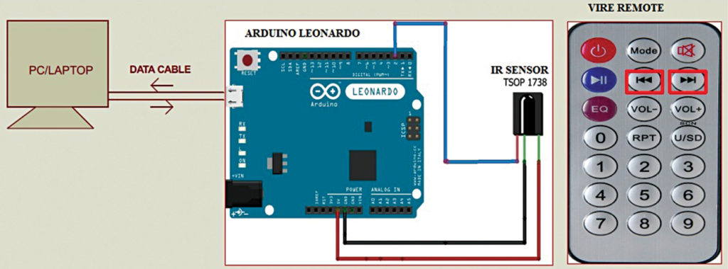

Slide 6
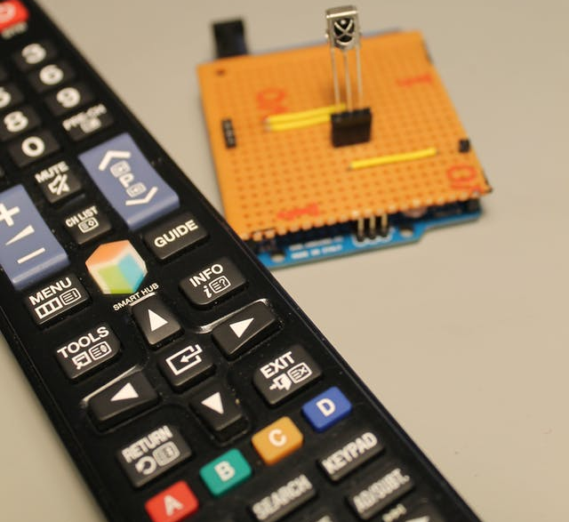
Implementation and Testing:
Understanding the language for Arduino and programming the microcontroller board for this specific task was a challenge.
During the implementation, there were some problems faced such as the availability of the needed components and discovering a faulty component. The components were replaced with other suitable components.

Slide 7
Results:
The project was completed after removing the mistakes and improving the project to its best level.

Slide 8
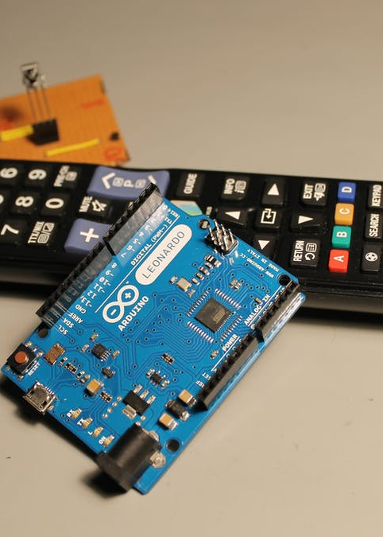
Conclusion
The cost-effective device is made to control PowerPoint presentation efficiently. In future, we can add more controls in it.

